Slide 1


Slide 2

SAGA Pattern

Slide 3
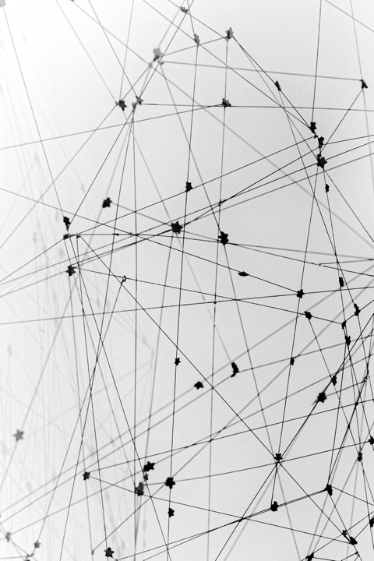
Section topic
Content
01 Distributed transactions
Compensating transactions
02 Ways for implementation
Introduction to two-phase commit (2pc)
Introduction to SAGA pattern
03 Demo - Implementation of SAGA
04 Questions & Links

Slide 4

Distributed transactions
4

Slide 5
What is Distributed transaction?​
distributed transaction is a set of operations on data that is performed across two or more databases. It is typically coordinated across separate nodes connected by a network (microservices)
There are two possible outcomes from distributed transaction:
1) all operations successfully complete
2) none of the operations are performed at all due to a failure somewhere in the system
Failure – if there is a failure at some point compensating transaction is started
5
Notes:
One big advantage of the Saga pattern is its support for long-lived transactions. Because each microservice focuses only on its own local atomic transaction, other microservices are not blocked if a microservice is running for a long time. This also allows transactions to continue waiting for user input. Also, because all local transactions are happening in parallel, there is no lock on any object.

Slide 6
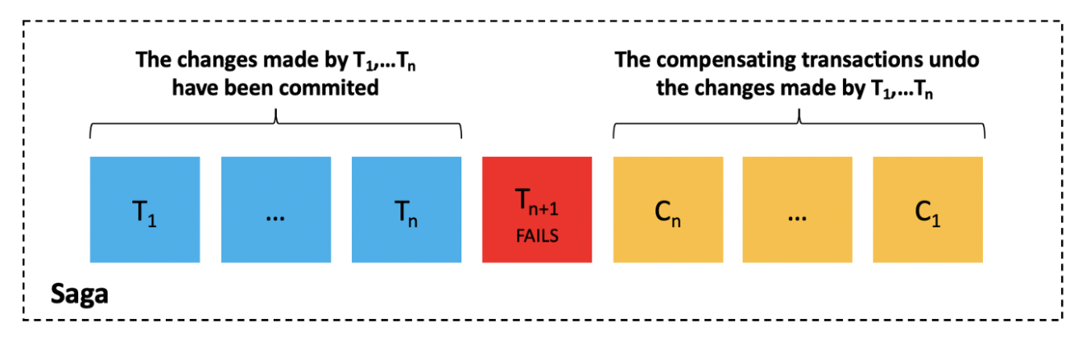
Compensating transactions
6

Slide 7
Why do we need Distributed transactions?​
Better performance - Distributed transactions are necessary when you need to quickly update related data that is spread across multiple databases.
Data consistency - distributed transaction will ensure that all records get updated. And if a failure occurs, the data will be reset to its original state and that will save the data integrity and consistency.
7
Notes:
One big advantage of the Saga pattern is its support for long-lived transactions. Because each microservice focuses only on its own local atomic transaction, other microservices are not blocked if a microservice is running for a long time. This also allows transactions to continue waiting for user input. Also, because all local transactions are happening in parallel, there is no lock on any object.

Slide 8
Ways for implementation
8

Slide 9
Two-phase commit (2pc) pattern
9

Slide 10
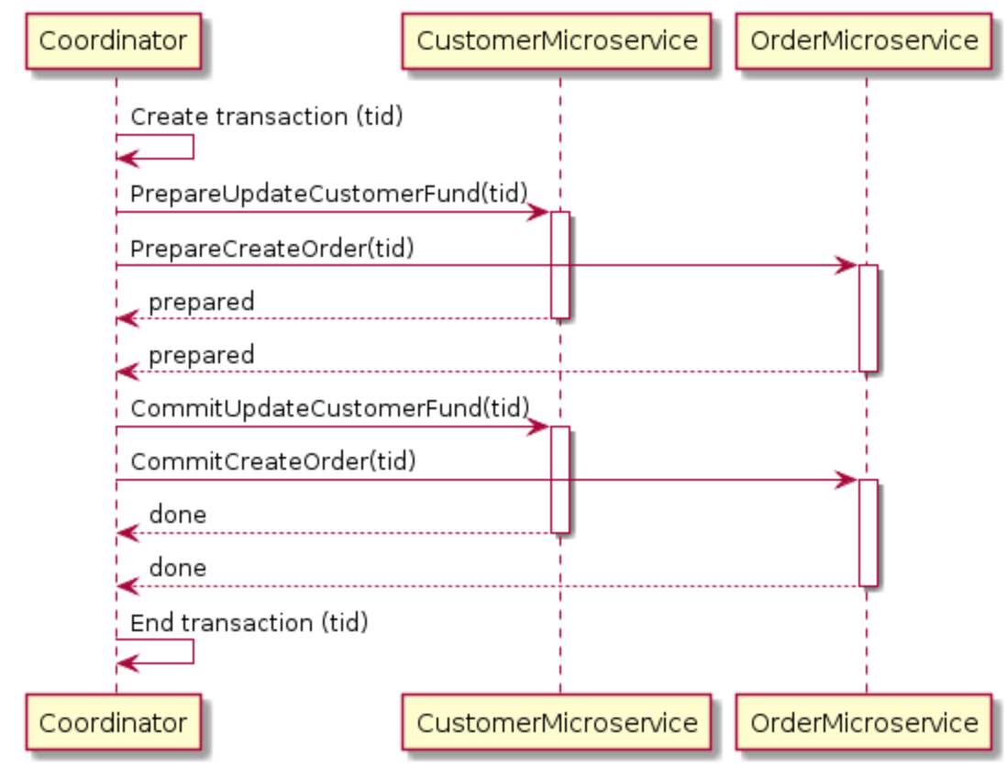
Introduction to Two-phase commit (2pc) pattern
Phases - prepare phase and a commit phase
XA protocol - protocol which is used for communication.
Coordinator - need to call the microservices in the prepare and commit phases.
10

Slide 11
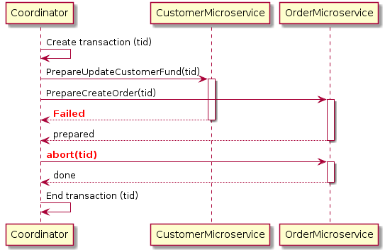
Failure - If at any point a single microservice fails to prepare, the Coordinator will abort the transaction and begin the rollback process. Here is a diagram of a 2pc rollback for the customer order example:
11

Slide 12
Advantages of using 2pc​
Atomic transactions - the prepare and commit phases guarantee that the transaction is atomic.
2pc allows read-write isolation - it means the changes on a field are not visible until the coordinator commits the changes.​
Disadvantages of using 2pc​
synchronous (blocking) - the protocol will need to lock the object that will be changed before the transaction completes. This prevents the customer from applying new orders.
12

Slide 13
SAGA Pattern
13

Slide 14
Introduction to Saga pattern
asynchronous and reactive - local transactions are coordinated using asynchronous messaging and events
avoid locks on non-local resources.
Compensating transactions - restore the original state.
There are two ways to implement SAGA pattern:
Orchestration
Choreography
14

Slide 15
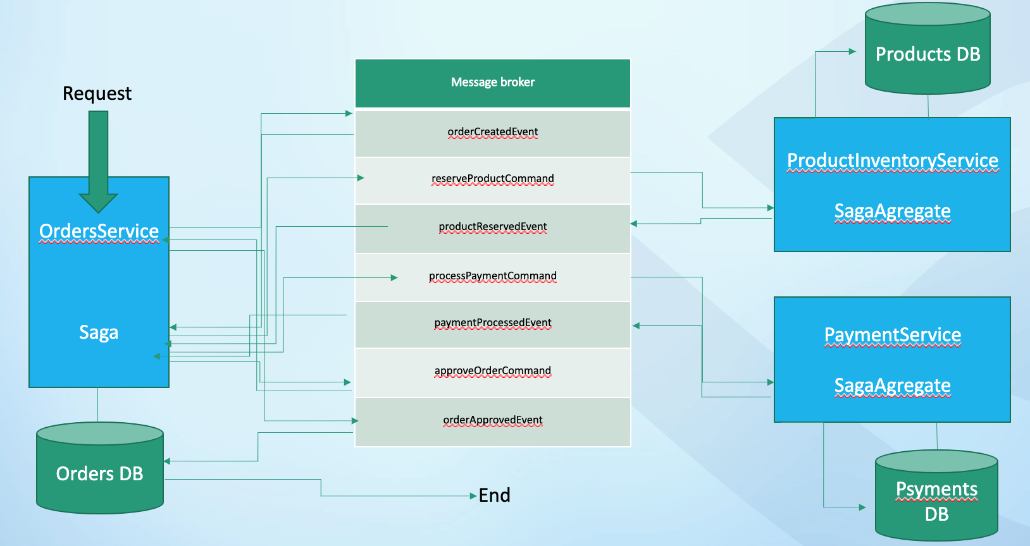
Orchestration – Saga plays a role of orchestrator
15

Slide 16
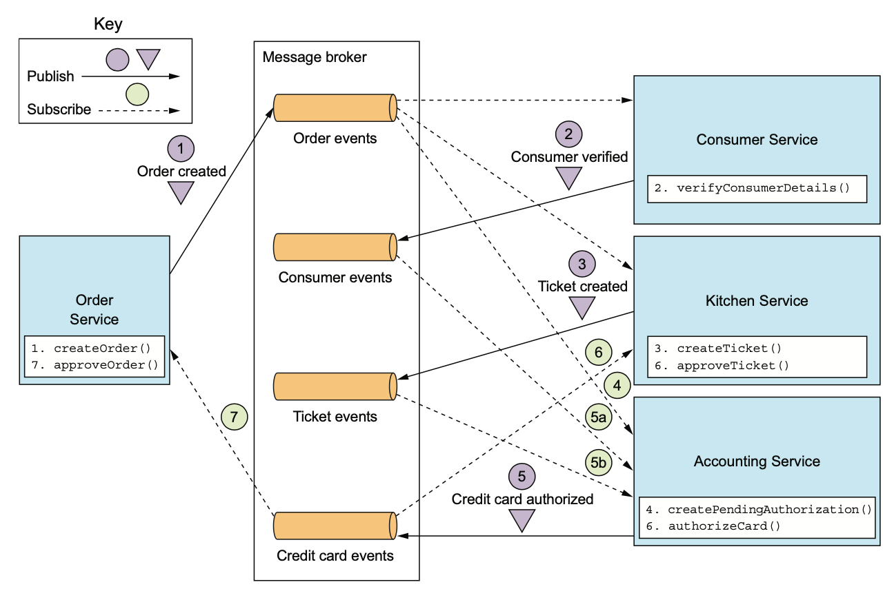
Choreography – there is no orchestrator
16

Slide 17
Advantages of the Saga pattern
Asynchronous - each microservice focuses only on its own local atomic transaction, other microservices are not blocked because all local transactions are happening in parallel, there is no lock on any object.
Disadvantages of the Saga pattern
Complexity
Main disadvantage of the Saga pattern is it does not have read isolation
17

Slide 18
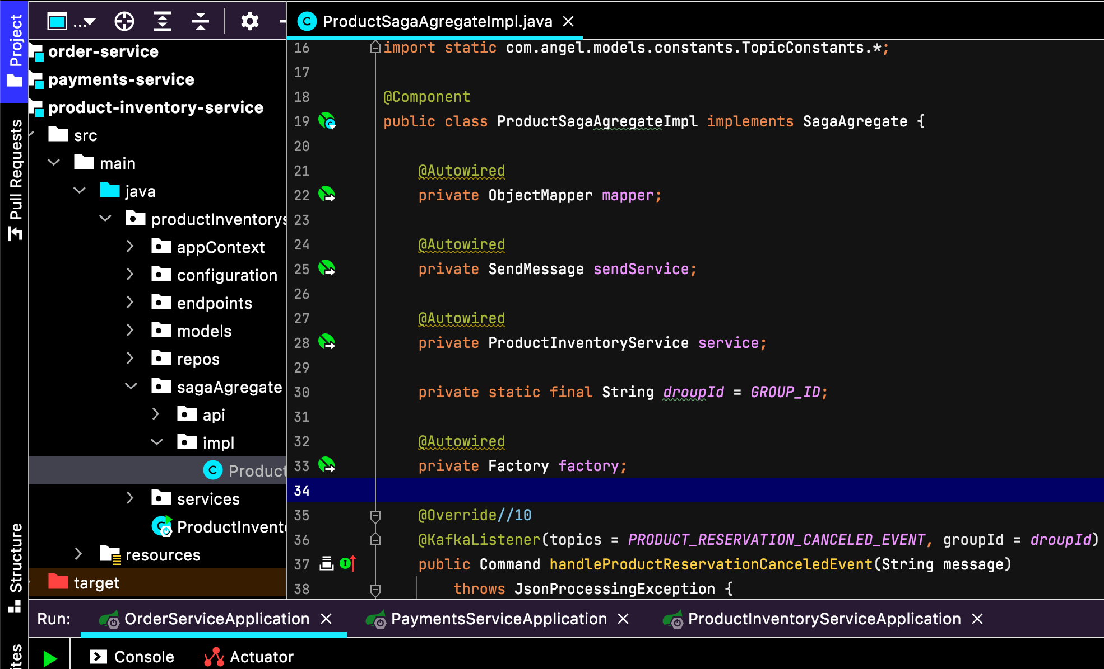
DEMO
18

Slide 19
Created order
Products DB
Message broker
orderCreatedEvent
reserveProductCommand
productReservedEvent
processPaymentCommand
paymentProcessedEvent
approveOrderCommand
orderApprovedEvent
Request
ProductInventoryService
SagaAgregate
OrdersService
Saga
PaymentService
SagaAgregate
Orders DB
Psyments DB
End
19

Slide 20
Compensating transaction
Message broker
orderCreatedEvent
reserveProductCommand
productReservedEvent
processPaymentCommand
paymentProcessedEvent
approveOrderCommand
orderApprovedEvent
productReservationCancelCommand
productReservationCanceledEvent
paymentCancelCommand
paymentCanceledEvent
orderRejectCommandPayment
orderRejectedEvent
orderRejectCommandProduct
orderRejectedEvent
Products DB
Request
ProductInventoryService
SagaAgregate
OrdersService
Saga
PaymentService
SagaAgregate
Fail – not enough balance
Orders DB
Payments DB
End
20

Slide 21
Links
https://github.com/acho999/saga-orchestration-impl - demo project repository
https://microservices.io/patterns/data/saga.html - Saga pattern article
https://www.udemy.com/course/apache-kafka/ - basic Kafka course
https://www.udemy.com/course/kafka-streams/ - Kafka-streams course
https://www.udemy.com/course/spring-boot-microservices-cqrs-saga-axon-framework/ - Event-driven Microservices course
https://enlear.academy/using-saga-pattern-in-microservices-3a638979e830 - lack of isolation article
https://docs.oracle.com/cd/E19509-01/820-5892/ref_xatrans/index.html - XA-protocol article
21

Slide 22
Q & A
22

